Slide 1
Cross Site Scripting in vulnweb
Subdomain:- http://testasp.vulnweb.com
Description: If a website directly incorporate user input into its body without proper sanitization this script wil run when the page load If a website directly incorporates user input into its body without proper sanitization, this script will run when the page loads.

Slide 2
Reflected XSS : In a reflected XSS attack the malicious script is embedded in a URL or input field.
Impact : Reflected XSS can lead to unauthorized access , data thef , or session hijacking. Affects users who were visit specific URL or interact with vulnerable input fields.

Slide 3
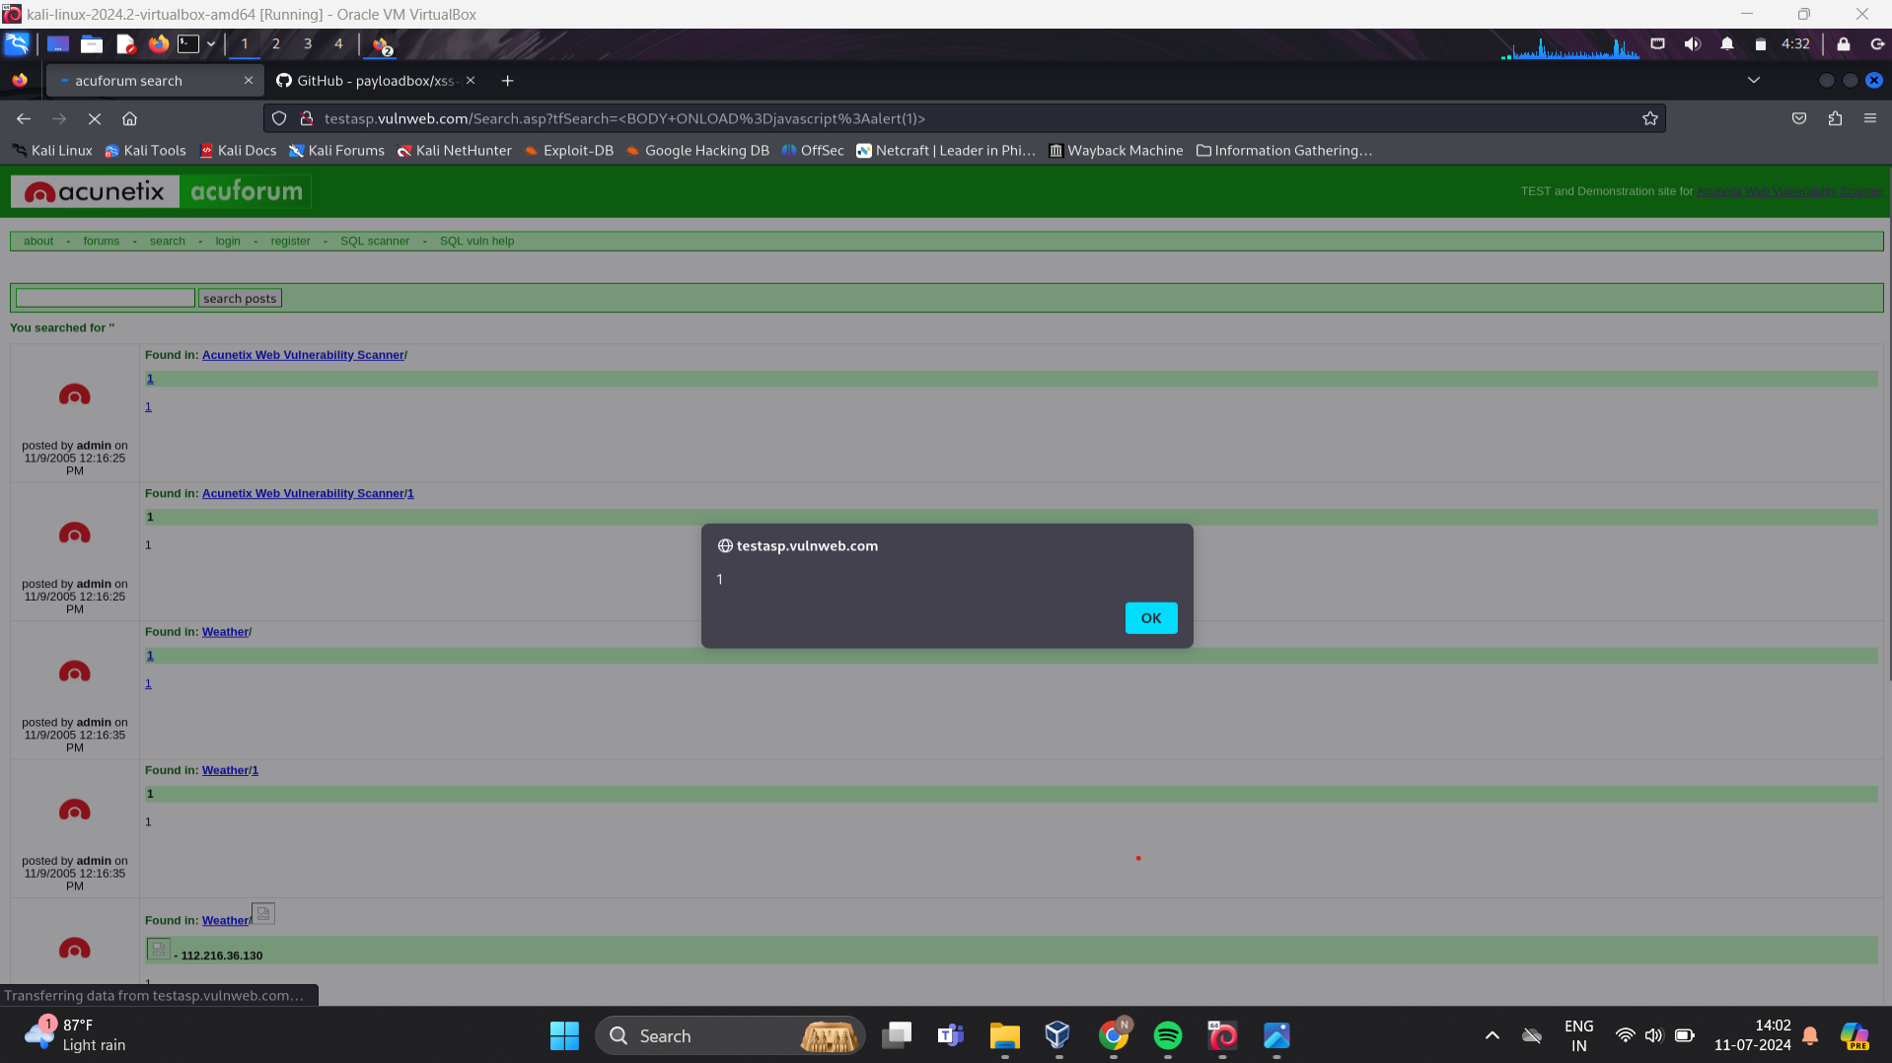
Proof of Concept:

Slide 4
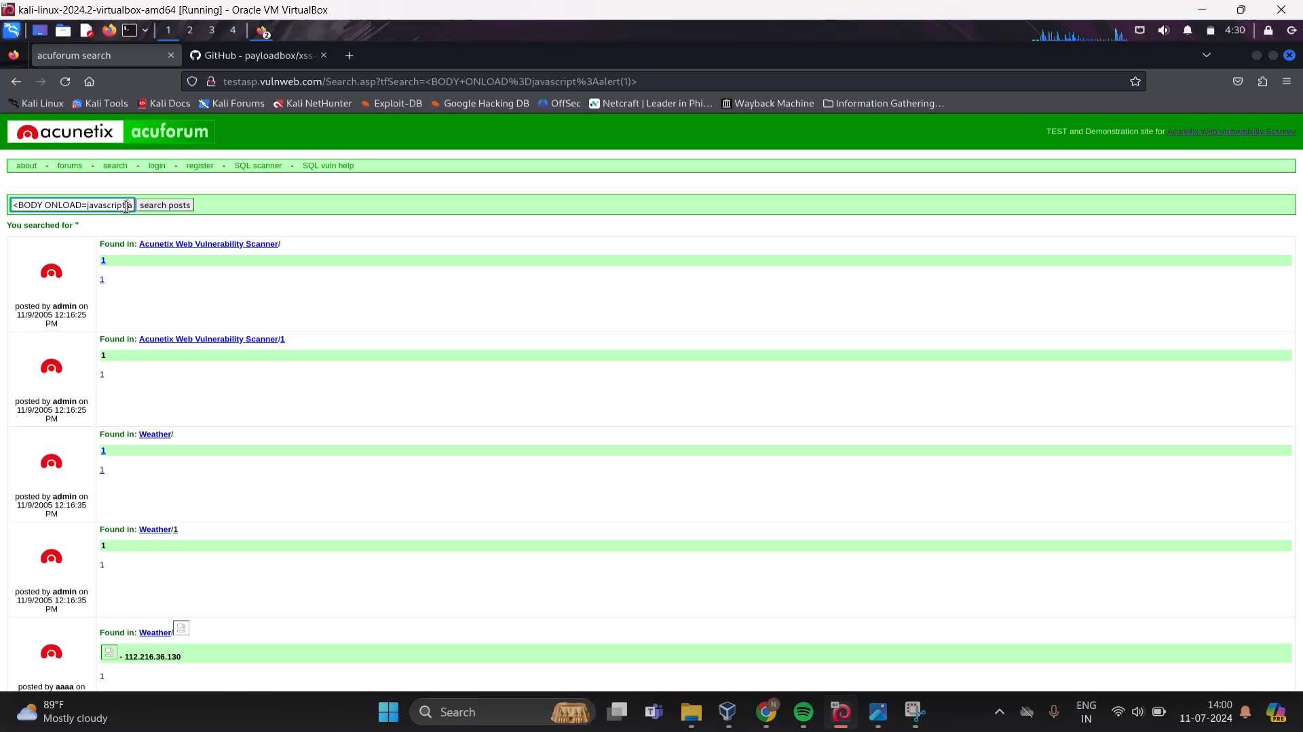
2) Proof of concept:

Slide 5
Vulnerbility XSS Script : <BODY ONLOAD=javascript:alert(1)>
Attack case and conditions: The vulnerbiltiy occurs when a web application incorporates user input into its HTML content without proper sanitization or output encoding.
If the application directly reflects user input within the <body> tag the injected script runs.

Slide 6
Mitigation:
Sanitize and authenticate user inputs to prevent script injection.
Always encode user-generated content before rendering it in HTML.
3) Implement a strong Content Security Policy (CSP) to restrict Script Execution.

